Slide 1
ADVANCED SQL
PL/SQL
PROCEDURES
FUNCTIONS
TRIGGERS
Notes:
Procedure is similar to programming lang procedure were group of SQL statements can be executed. Defined/cretaed to do particular task. Similar to programing lang it also has declrataion and body part.
Triggers are the PL/SQL block which is associated with table and when ever modification happens to the table the trigger is fired. Which is going to take or execute specified actions.

Slide 2
PL/SQL
PL/SQL is Oracle's procedural language extension to SQL, the non-procedural relational database language.
With PL/SQL, you can use SQL statements to manipulate ORACLE data and the flow of control statements to process the data. Moreover, you can declare constants and variables, define subprograms (procedures and functions), and trap runtime errors.
Thus, PL/SQL combines the data manipulating power of SQL with the data processing power of procedural languages.

Slide 3
DIFFERENCE BETWEEN PL/SQL AND SQL
When a SQL statement is issued on the client computer, the request is made to the database on the server, and the result set is sent back to the client.
As a result, a single SQL statement causes two trips on the network. If multiple SELECT statements are issued, the network traffic increase significantly very fast. For example, four SELECT statements cause eight network trips.
If these statements are part of the PL/SQL block, they are sent to the server as a single unit. The SQL statements in this PL/SQL program are executed at the server and the result set is sent back as a single unit. There is still only one network trip made as is in case of a single SELECT statement.

Slide 4
PL/SQL BLOCKS
PL/SQL blocks can be divided into two groups:
  Named and
  Anonymous.
Named blocks are used when creating subroutines. These subroutines are procedures, functions, and packages.
The subroutines can be stored in the database and referenced by their names later on.
In addition, subroutines can be defined within the anonymous PL/SQL block.
Anonymous PL/SQL blocks do not have names. As a result,they cannot be stored in the database and referenced later.

Slide 5
PL/SQL BLOCK STRUCTURE
PL/SQL blocks contain three sections
  Declare section
  Executable section and
  Exception-handling section.
The executable section is the only mandatory section of the block.
Both the declaration and exception-handling sections are optional.

Slide 6
PL/SQL BLOCK STRUCTURE
PL/SQL block has the following structure:
  DECLARE
  Declaration statements
  BEGIN
  Executable statements
  EXCEPTION
  Exception-handling statements
  END ;

Slide 7
DECLARATION SECTION
The declaration section is the first section of the PL/SQL block.
It contains definitions of PL/SQL identifiers such as variables, constants, cursors and so on.
Example
  DECLARE
  v_first_name VARCHAR2(35) ;
  v_last_name VARCHAR2(35) ;
  v_counter NUMBER := 0 ;

Slide 8
EXECUTABLE SECTION
The executable section is the next section of the PL/SQL block.
This section contains executable statements that allow you to manipulate the variables that have been declared in the declaration section.
  BEGIN
  SELECT first_name, last_name
  FROM student
  WHERE student_id = 123 ;
  DBMS_OUTPUT.PUT_LINE
  (‘Student name :’ || first_name ||‘ ’|| last_name);
  END;

Slide 9
EXCEPTION-HANDLING SECTION
The exception-handling section is the last section of the PL/SQL block.
This section contains statements that are executed when a runtime error occurs within a block.
Runtime errors occur while the program is running and cannot be detected by the PL/SQL compiler.
    EXCEPTION
    WHEN NO_DATA_FOUND THEN
    DBMS_OUTPUT.PUT_LINE
    (‘ There is no student with student id 123 ’);
    END;

Slide 10
PL/SQL EXAMPLE
DECLARE
v_first_name VARCHAR2(35);
v_last_name VARCHAR2(35);
BEGIN
SELECT first_name, last_name
INTO v_first_name, v_last_name
FROM student
WHERE student_id = 123;
DBMS_OUTPUT.PUT_LINE
('Student name: '||v_first_name||' '||v_last_name);
EXCEPTION
WHEN NO_DATA_FOUND THEN
DBMS_OUTPUT.PUT_LINE
('There is no student with student id 123');
END;

Slide 11
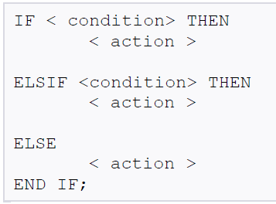
Programmatic Control Constructs
If-Then-ElsIf-Else-End If :

Slide 12
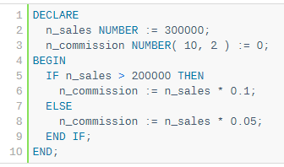

Slide 13
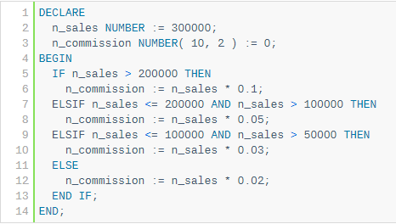

Slide 14
BASIC LOOPS IN PL/SQL
sequence of statements is enclosed between the LOOP and the END LOOP statements. At each iteration, the sequence of statements is executed and then control resumes at the top of the loop.

Slide 15
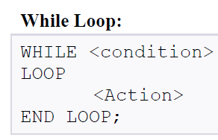
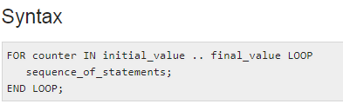
Notes:
The value of index starts from lower_bound and increases by one with each iteration of the loop until it reaches upper_bound. If the upper_bound value is less than the lower_bound, then the statements never executed. The Reverse option is used to start the index value from the upper_bound and index is decremented by one in each iteration till index value reaches lower_bound.

Slide 16
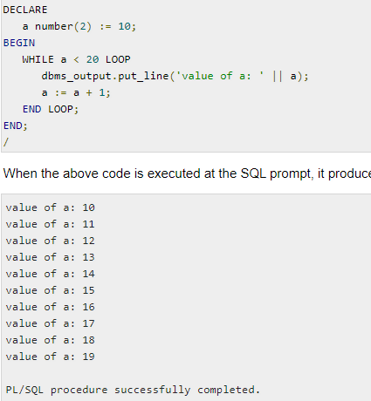

Slide 17
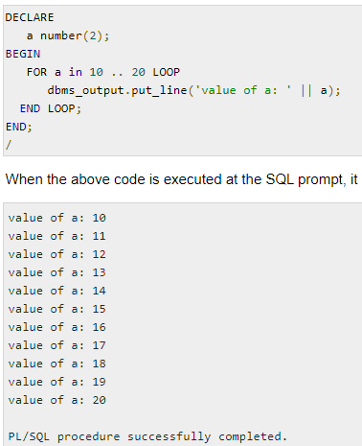

Slide 18
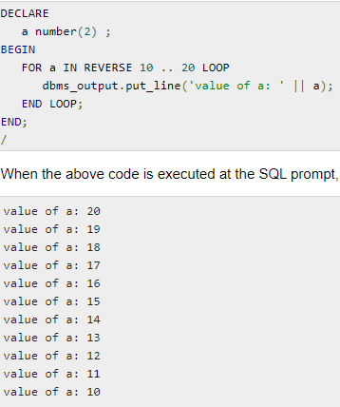
Reverse FOR LOOP Statement

Slide 19
Case Statement
CASE [TRUE | selector]
WHEN expression1 THEN
sequence_of_statements1;
WHEN expression2 THEN
sequence_of_statements2;
...
WHEN expressionN THEN
sequence_of_statementsN;
[ELSE sequence_of_statementsN+1;]
END CASE [label_name];

Slide 20
// Case statement
DECLARE
grade CHAR(1);
BEGIN
grade := 'B';
CASE grade
WHEN 'A' THEN DBMS_OUTPUT.PUT_LINE('Excellent');
WHEN 'B' THEN DBMS_OUTPUT.PUT_LINE('Very Good');
WHEN 'C' THEN DBMS_OUTPUT.PUT_LINE('Good');
ELSE DBMS_OUTPUT.PUT_LINE('No such grade');
END CASE;
Notes:
--Simulating STEP Clause in FOR LOOP Statement
DECLARE step PLS_INTEGER := 5;
BEGIN
FOR i IN 1..3 LOOP
DBMS_OUTPUT.PUT_LINE (i*step);
END LOOP; END; /

Slide 21
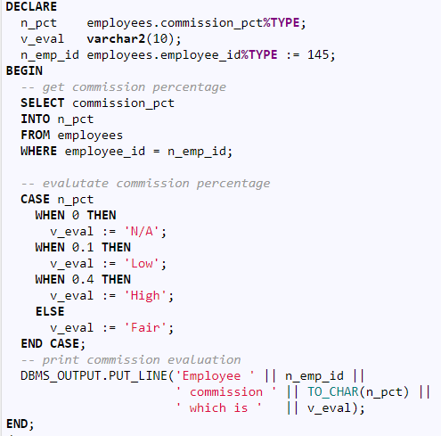

Slide 22
Procedure
A Procedure is a subprogram unit that consists of a group of PL/SQL statements. Each procedure in Oracle has its own unique name by which it can be referred. This subprogram unit is stored as a database object.
A stored procedure or in simple term, a proc is a named PL/SQL block which performs one or more specific task. This is similar to a procedure in other programming languages.

Slide 23
PROCEDURES
The syntax for creating a procedure is as follows:
    CREATE OR REPLACE PROCEDURE name
(<parameterl IN/OUT <datatype>)
    [AS | IS]
    [local declarations]
    BEGIN
    executable statements
    [EXCEPTION
    exception handlers]
    END [name];

Slide 24
CREATE PROCEDURE instructs the compiler to create new procedure. Keyword 'OR REPLACE' instructs the compile to replace the existing procedure (if any) with the current one.
Procedure name should be unique.
Keyword 'IS' will be used, when the procedure is nested into some other blocks. If the procedure is standalone then 'AS' will be used. Other than this coding standard, both have the same meaning

Slide 25
CREATE OR REPLACE PROCEDURE greetings
AS
BEGIN
dbms_output.line(“Hello world”);
END;
--------------------------------------------
When the above code is executed using the SQL prompt, it will produce the following result − PROCEDURE CREATED
EXECUTE greetings;

Slide 26
create table named emp have two column id and salary with number datatype.
CREATE OR REPLACE PROCEDURE emp_insert(id IN NUMBER, sal IN NUMBER) IS
BEGIN
INSERT INTO emp VALUES(id, sal);
DBMS_OUTPUT.PUT_LINE('VALUE INSERTED.');
END;
/
Procedure created.
SET SERVEROUTPUT ON;
EXECUTE emp_insert(101,2000);
procedure successfully completed.

Slide 27
// Insert a person information into a PERSON table provided his information does not exist already.
CREATE OR REPLACE PROCEDURE insertPerson ( id IN VARCHAR, DOB IN DATE, fname IN VARCHAR, lname IN VARCHAR)
IS
counter INTEGER; --declaration part
BEGIN
SELECT COUNT(*) INTO counter FROM person p WHERE p.pid = id;
IF (counter > 0) THEN
-- person with the given pid already exists
DBMS_OUTPUT.PUT_LINE('WARNING Inserting person: person with pid ' || id || ' already exists!');
ELSE
INSERT INTO person VALUES (id, DOB, fname, lname);
DBMS_OUTPUT.PUT_LINE('Person with pid ' || id || ' is inserted.');
END IF;
END;
/

Slide 28
Example
In order to execute a procedure use the following syntax:
EXECUTE Procedure_name;
Or EXEC Procedure_name;
SQL> EXECUTE insertPerson (‘p1’, ’10-10-2000’, ‘John’, ’Smith’) ;
To see the o/p on the screen use following command
SET SERVEROUTPUT ON

Slide 29
Parameter
The parameter is variable or placeholder of any valid PL/SQL datatype through which the PL/SQL subprogram exchange the values with the main code. This parameter allows to give input to the subprograms and to extract from these subprograms.
These parameters should be defined along with the subprograms at the time of creation.
These parameters are included in the calling statement of these subprograms to interact the values with the subprograms.
The datatype of the parameter in the subprogram and the calling statement should be same.
The size of the datatype should not mention at the time of parameter declaration, as the size is dynamic for this type.

Slide 30
PARAMETERS
Parameters are the means to pass values to and from the calling environment to the server.
These are the values that will be processed or returned via the execution of the procedure.
There are three types of parameters:
IN, OUT, and IN OUT.
IN passes value into the procedure, OUT passes back from the procedure and INOUT does both.

Slide 31
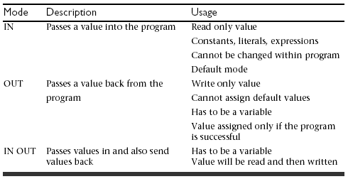
Types of Parameters

Slide 32
// Procedure calls another procedure
CREATE OR REPLACE PROCEDURE insertFaculty (pid IN VARCHAR, DOB IN DATE, fname IN VARCHAR, lname IN VARCHAR, rank IN VARCHAR, dept IN VARCHAR) IS
BEGIN
insertPerson (pid, DOB, fname, lname); // User defined Procedure
insert into facultyEDB values(pid, rank, dept);
DBMS_OUTPUT.PUT_LINE('Faculty with pid ' || pid || ' is inserted.');
END insertFaculty;
EXECUTE insertFaculty('121-11-1111', '21-OCT-1961', 'Susan', 'Urban', 'Emeritus', 'CSE');
-- from sql prompt

Slide 33
FUNCTIONS
Functions are a type of stored code and are very similar to procedures.
The significant difference is that a function is a PL/SQL block that returns a single value.
Functions can accept one, many, or no parameters, but a function must have a return clause in the executable section of the function.
The datatype of the return value must be declared in the header of the function.
A function is not a stand-alone executable in the way that a procedure is: It must be used in some context.
A function has output that needs to be assigned to a variable, or it can be used in a SELECT statement.

Slide 34
FUNCTIONS
The function does not necessarily have to have any parameters, but it must have a RETURN value declared in the header, and it must return values for all the varying possible execution streams.
The RETURN statement does not have to appear as the last line of the main execution section, and there may be more than one RETURN statement (there should be a RETURN statement for each exception).

Slide 35
FUNCTIONS
The syntax for creating a function is as follows:
    CREATE [OR REPLACE] FUNCTION function_name
    (parameter list)
    RETURN datatype
    IS|AS
    BEGIN
    <body>
    RETURN (return_value);
    END;

Slide 36
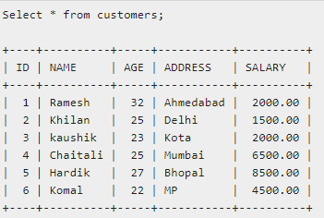

Slide 37
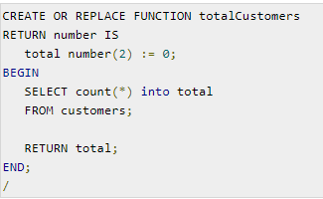

Slide 38
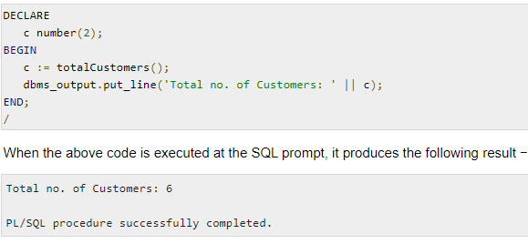

Slide 39
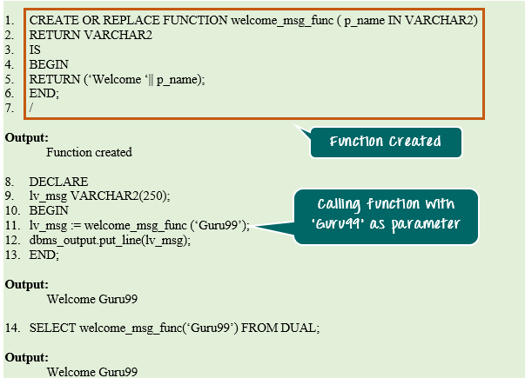

Slide 40
Example
    CREATE OR REPLACE FUNCTION show_description (i_course_no IN number)
    RETURN varchar2
    AS
    v_description varchar2(50);
    BEGIN
    SELECT description
    INTO v_description
    FROM course
    WHERE course_no = i_course_no;
    RETURN v_description;
    EXCEPTION
    WHEN NO_DATA_FOUND
    THEN
    RETURN('The Course is not in the database');
    WHEN OTHERS
    THEN
    RETURN('Error in running show_description');
    END;

Slide 41
Making Use Of Functions
In a anonymous block
    DECLARE
    v_description VARCHAR2(50);
    BEGIN
    v_description := show_description(&sv_cnumber);
    DBMS_OUTPUT.PUT_LINE(v_description);
    END;
In a SQL statement
    SELECT course_no, show_description(course_no)
    FROM course;
SET SERVEROUTPUT ON
Notes:
In first part we display the description for the enter course value from the keyboard.
In second part we are displaying course no along with its description.

Slide 42
TRIGGERS
A database trigger is a stored PL/SQL program unit associated with a specific database table.
ORACLE executes (fires) a database trigger automatically when a given SQL operation (like INSERT, UPDATE or DELETE) affects the table.
Unlike a procedure, or a function, which must be invoked explicitly, database triggers are invoked implicitly.
Notes:
Trigger is used to handle the complex constraints , security and authentication purpose.
Triggers are Associated with a database table or action
It is fired when ever modifications happen to the table or actions takes place with db.
Give example for each: Salary updation-> mail to supervisor, When employee leave the company move his information into Xemployee table
Send mail to DBA when somebody logs into the system during weekends.
Or to maintain log about database/table updation
Usage of triggers are like:
to specify complex constraints
Security
Logging of database access
E.g. date and time each user logs on
E.g. deny access at weekend
Maintaining synchronous replicates
In a distributed database
Generating statistics on table access

Slide 43
TRIGGERS
Database triggers can be used to perform any of the following:
Audit data modification
Log events transparently
Enforce complex business rules , eg: Mgr’s salary must be more than his subordinates.

Slide 44
TRIGGERS
You can associate up to 12 database triggers with a given table.
A database trigger has three parts:
a triggering event, an optional trigger constraint, and a trigger action.
When an event occurs, a database trigger is fired, and an predefined PL/SQL block will perform the necessary action.

Slide 45
TRIGGERS
SYNTAX:
CREATE [OR REPLACE] TRIGGER trigger_name
{BEFORE|AFTER} triggering_event ON table_name
[FOR EACH ROW]
[WHEN (condition) ]
DECLARE
Declaration statements
BEGIN
Executable statements
EXCEPTION
Exception-handling statements
END;
Notes:
optional trigger constraint--when

Slide 46
TRIGGERS
The trigger_name references the name of the trigger.
BEFORE or AFTER specify when the trigger is fired (before or after the triggering event).
The triggering_event references a DML statement issued against the table (e.g., INSERT, DELETE, UPDATE).
The table_name is the name of the table associated with the trigger.
The clause, FOR EACH ROW, specifies a trigger is a row trigger and fires once for each modified row.
Bear in mind that if you drop a table, all the associated triggers for the table are dropped as well.

Slide 47
TYPES OF TRIGGERS
A trigger may be a ROW or STATEMENT type. If the statement FOR EACH ROW is present in the CREATE TRIGGER clause of a trigger, the trigger is a row trigger. A row trigger is fired for each row affected by an triggering statement.
A statement trigger, however, is fired only once for the triggering statement, regardless of the number of rows affected by the triggering statement

Slide 48
TYPES OF TRIGGERS
Example: statement trigger
CREATE OR REPLACE TRIGGER mytrig1
BEFORE DELETE OR INSERT OR UPDATE ON employee
BEGIN
IF (TO_CHAR(SYSDATE, 'day') IN ('sat', 'sun')) OR
(TO_CHAR(SYSDATE,'hh:mi') NOT BETWEEN '08:30' AND '18:30')
THEN RAISE_APPLICATION_ERROR(-20500, 'table is secured');
END IF;
END;
/
Notes:
The above example shows a trigger that limits the DML actions to the employee table to weekdays from 8.30am to 6.30pm. If a user tries to insert/update/delete a row in the EMPLOYEE table, a warning message will be prompted.

Slide 49
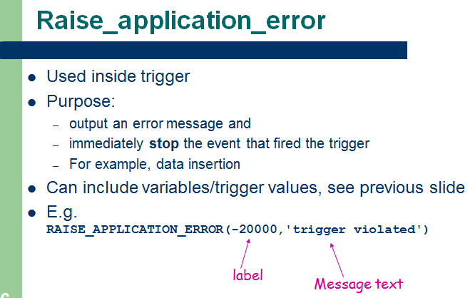

Slide 50
:OLD and :NEW
When a DML statement changes a column, the old and new values are visible to the executing code
This is done by prefixing the table column with :old or :new
:new is useful for INSERT and UPDATE
:old is useful for DELETE and UPDATE
Eg :old.emp_salary :new.emp_salary
triggers may fire other triggers in which case they are CASCADING. Try not to create too many interdependencies with triggers!

Slide 51
Example: ROW Trigger
CREATE OR REPLACE TRIGGER mytrig2
AFTER DELETE OR INSERT OR UPDATE ON employee
FOR EACH ROW
BEGIN
IF DELETING THEN
INSERT INTO xemployee (emp_ssn, emp_last_name, emp_first_name, del_date)
VALUES (:old.emp_ssn, :old.emp_last_name, :old.emp_first_name, sysdate);
ELSIF INSERTING THEN
INSERT INTO nemployee (emp_ssn, emp_last_name, emp_first_name, add_date)
VALUES (:new.emp_ssn, :new.emp_last_name , :new.emp_first_name, sysdate);
ELSIF UPDATING('emp_salary') THEN
INSERT INTO cemployee (emp_ssn, oldsalary, newsalary, up_date)
VALUES (:old.emp_ssn, :old.emp_salary, :new.emp_salary, sysdate);
END IF;
END;
/

Slide 52
// If person’s department changes and earlier he is the chairperson for that department, then for that department chair is set to NULL in department table.
CREATE OR REPLACE TRIGGER faculty_after_update_row
AFTER UPDATE ON facultyEDB // Here facultyEDB has dept and pid attributes.
FOR EACH ROW
BEGIN
IF UPDATING ('dept') AND :old.dept <> :new.dept
THEN UPDATE department SET chair = NULL WHERE chair = :old.pid;
END IF;
END; /
// When faculty is deleted from a faculty table , delete his information from Person table
CREATE OR REPLACE TRIGGER faculty_after_delete_row
AFTER DELETE ON facultyEDB
FOR EACH ROW BEGIN
DELETE FROM person WHERE pid = :old.pid;
END; /

Slide 53
%TYPE
Table: Agents (aid, aname, city, percent )
DECLARE
percent_val agents.percent%TYPE;
BEGIN
SELECT percent INTO percent_val FROM agents WHERE aid = 'a02';
IF percent_val > 50 THEN
INSERT INTO agents (aid, aname, city) VALUES (
'a07', 'John', 'Corpus');
END IF;
END; /
Notes:
An item declared with %TYPE (the referencing item) always inherits the data type of the referenced item.

Slide 54
%ROWTYPE
DECLARE
dept_rec departments%ROWTYPE;
BEGIN
SELECT * INTO dept_rec -- Can access only one tuple
FROM departments
WHERE department_id = 30 ;
DBMS_OUTPUT.PUT_LINE
(‘Dept infor: ' || dept_rec .Name ||’ ‘|| dept_rec.Head_Name) ;
END;
/
Notes:
The %ROWTYPE attribute lets you declare a record that represents a row in a table or view. For each column in the referenced table or view, the record has a field with the same name and data type. To reference a field in the record, use record_name.field_name.

Slide 55
ENABLING, DISABLING, DROPPING TRIGGERS
SQL>ALTER TRIGGER trigger_name DISABLE;
SQL>ALTER TABLE table_name DISABLE ALL TRIGGERS;
To enable a trigger, which is disabled, we can use the following syntax:
SQL>ALTER TABLE table_name ENABLE trigger_name;
All triggers can be enabled for a specific table by using the following command
SQL> ALTER TABLE table_name ENABLE ALL TRIGGERS;
SQL> DROP TRIGGER trigger_name
Notes:
Order of execution –if different triggers are raised on same table
Before update/insert/delete, statement level
Before update/insert/delete, row level
After update/insert/delete, Row level
After update/insert/delete, statement level

Slide 56
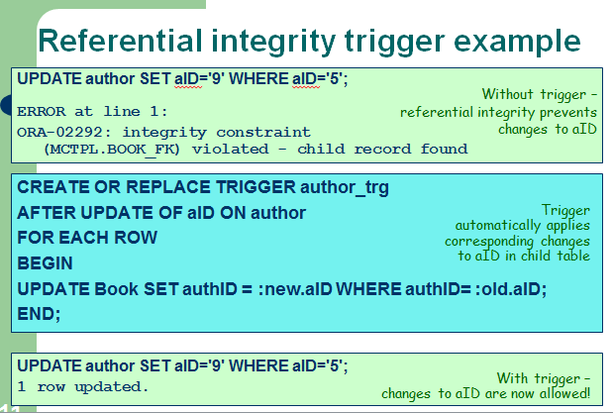

Slide 57
Example trigger: Incorporating business rules
To raise a message if more than 1000 books from the same publisher has been added to the “Book” table.
CREATE OR REPLACE TRIGGER publish_trg
BEFORE INSERT OR UPDATE ON book
FOR EACH ROW
DECLARE
how_many NUMBER;
BEGIN
SELECT COUNT(*) INTO how_many FROM book
WHERE publisher = :new.publisher;
IF how_many >= 1000 then
Raise_application_error(-20000,'Publisher' ||
:new.publisher || 'already has 1000 books');
END IF;
END;

Slide 58
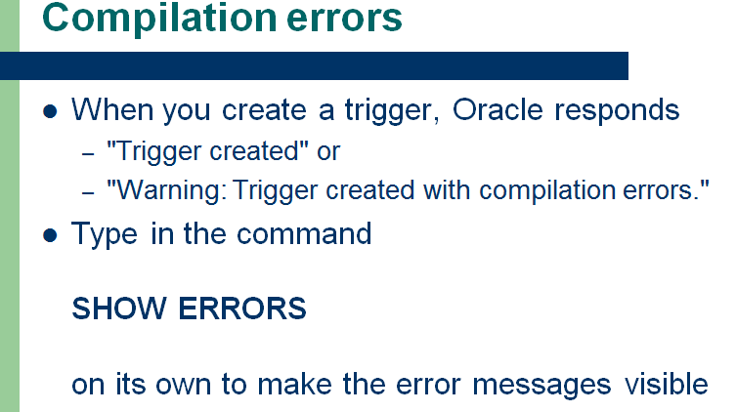

Slide 59
